Slide 1
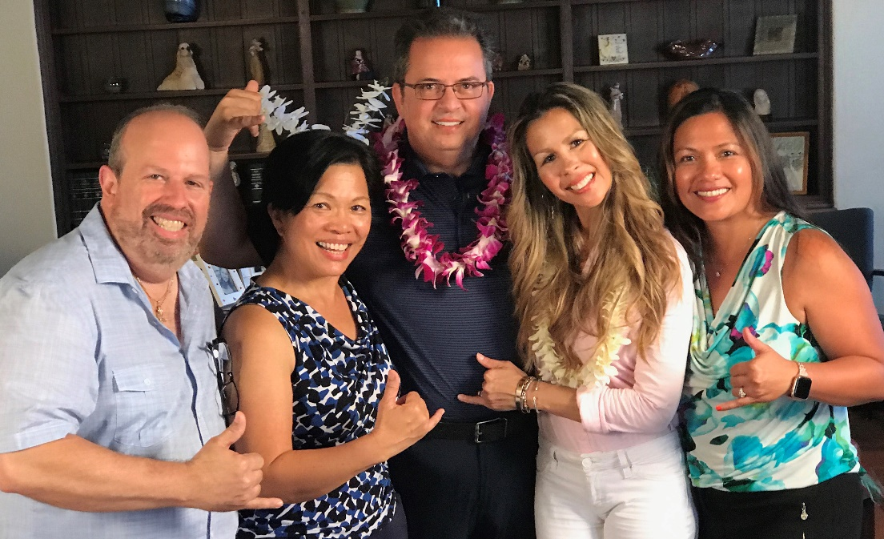
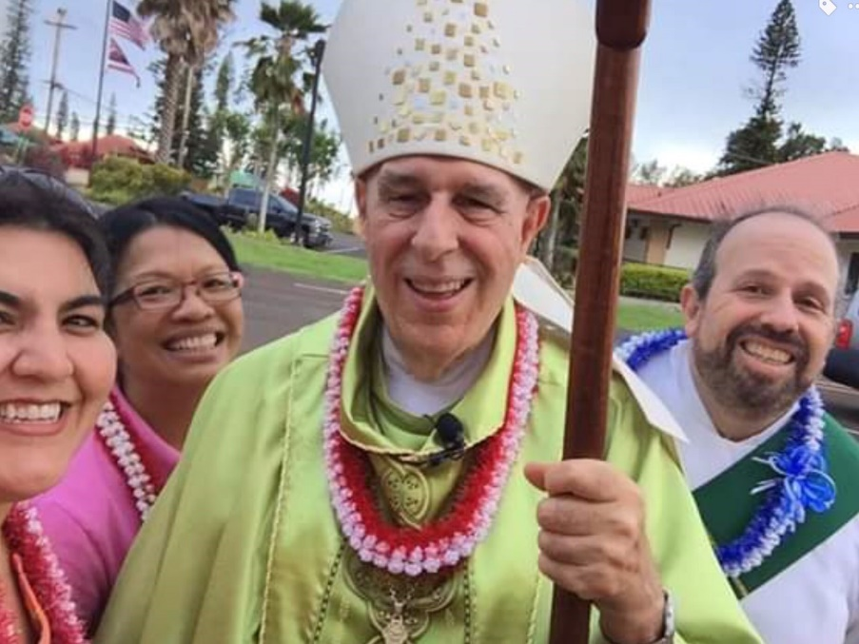
"Go, therefore, and make disciples of all nations, baptizing them in the name of the Father, and of the Son, and of the holy Spirit, teaching them to observe all that I have commanded you. And behold, I am with you always, until the end of the age." (Mt 28:19-20)
(from left)Dcn. Modesto Cordero and Jayne collaborate with school and parish catechists Glenn, Tammy, and Bernadette to produce a video on the sacraments.
Lisa Gomes - Youth & Young Adult Ministries - collaborate with us in service to Bishop Larry Silva.

Slide 2
And behold, I am with you always, until the end of the age." (Mt 28:19-20)
opportunities for cross-articulation;
presentations or coffee talks with leaders of various parish ministries;
acts of community service include opportunities for engagement;
Catechetical Sunday 2020 “I received from the Lord what I also handed on to you.”

Slide 3
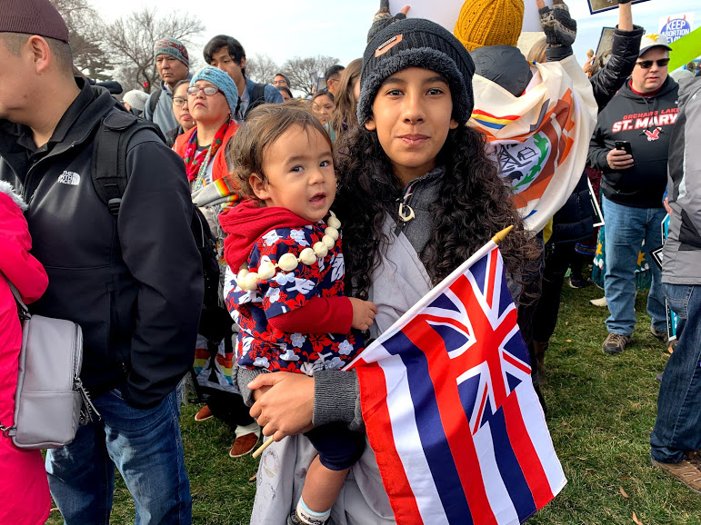
…inviting catechists and the families we serve to share their stories of faith through their cultural lens.
Mariah Waimea Carter and her brother Ignatius.

Slide 4
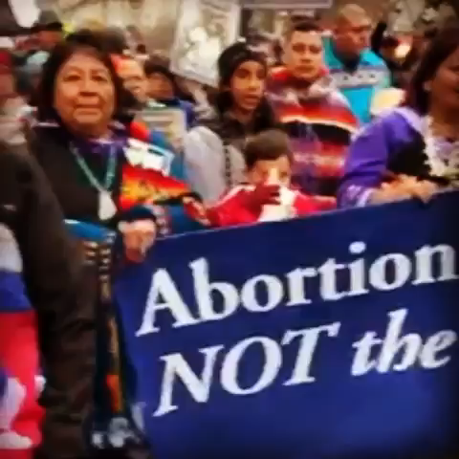
Mariah Waimea Carter offers an oli (chant) at the Pro-Life Rally in Washington, D.C. Her brother Augustine blows the pū (conch), calling attention to the importance of her message.

Slide 5

While our ministry calls us to serve in a particular way, we cannot, nor were we meant to minister in silos. Jesus’ promise of accompaniment animates the whole Christian community. We grow in our role as catechists and in faith together – as one body, one spirit in Christ. Identify opportunities to collaborate across ministries and cultures.
Reflection

